Slide 1
My Pet Arbitrage
Tracy Chen & Kimberly Zhang

Slide 2
Purpose
-Comprehensive solution to increase financial literacy among people of ages 16-21
- Based on math finance, economics, psychology
2 Pillars:
Positive/Negative reinforcement with a cute avatar: seek to change spending/saving habits of users
Adaptable planning of future spending goals: amount to save changes depending on expected future market and economic conditions

Slide 3
Features
Projection of savings to meet a certain goal
Logging of daily expenses to help users understand their spending habits
Interaction with your pet to receive relevant financial advice and view your financial health

Slide 4
Projection of Savings
Retirement:
Take current age and retirement age
Assuming user will live until 80 and that inflation is at 2.5%
Having future monthly expense based on current monthly expense adjusted for inflation
Determining lump sum amount needed at retirement
Ideally use forward rates for growth rates, due to unavailability of Bloomberg, take the Moving Average of S&P growth rate as our interest rate to compound savings each year until retirement. Note if rates are negative, use 10 year bond yields. The summation of these cash flows equal the lump sum.

Slide 5
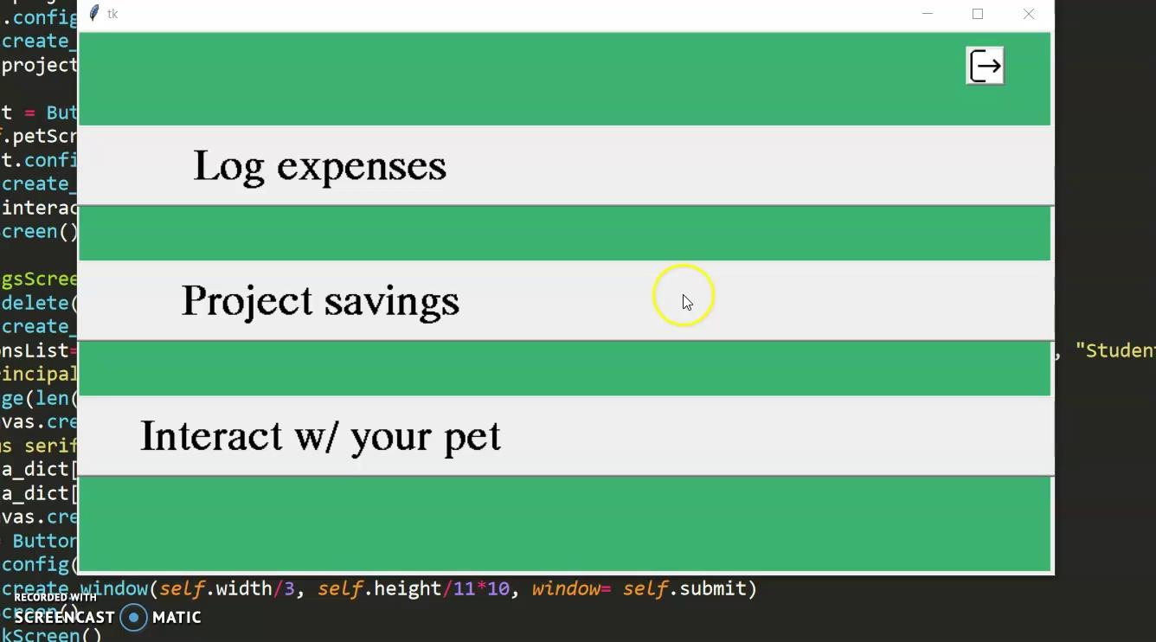
Projection of Savings
Retirement Planning Feature

Slide 6
Projection of Savings
Student Loans:
Assuming a federal loan with average rate of 5.8%
Daily Interest Rates are converted to monthly interest payments.
Total Interest Payment and Principal (loan amount) summed and divided over the span of monthly payments across 10 years
Display the amortized payments over a time span of 10 years

Slide 7
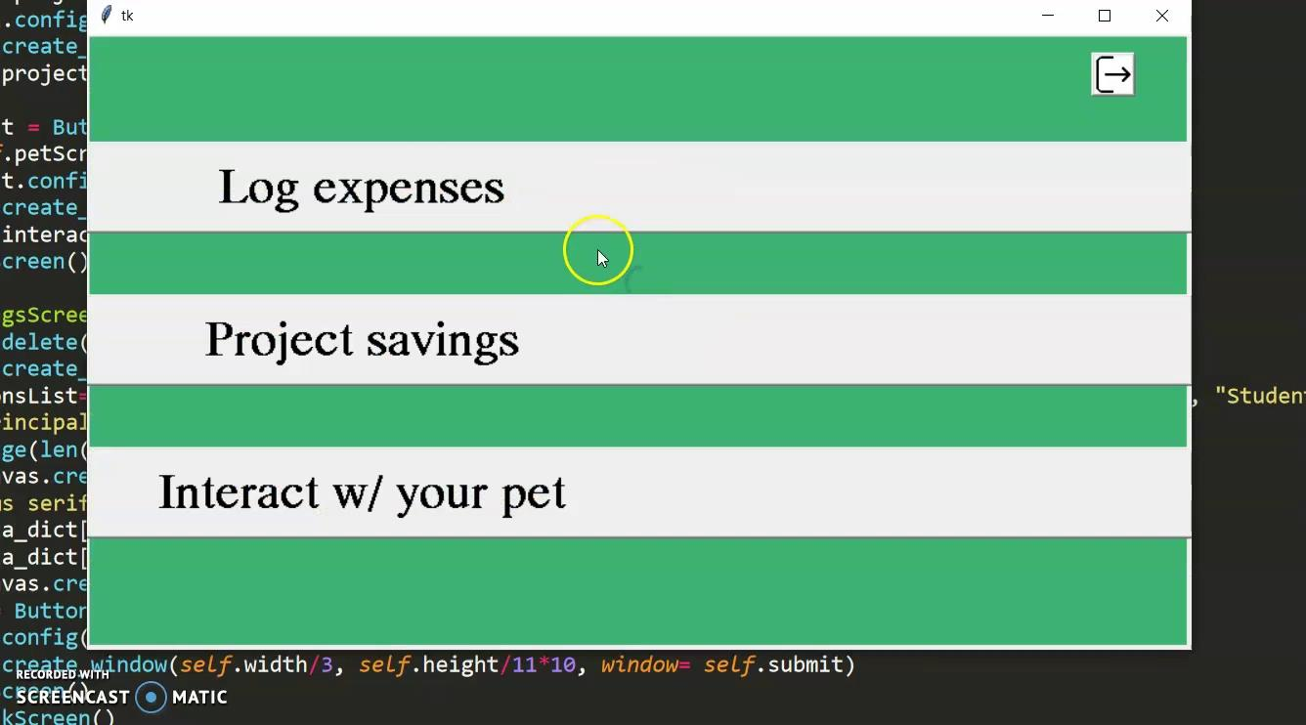
Logging of Daily Expenses
The user can input monthly income, expenses, and their goals for retirement, student loans, etc.
Can Save Daily Expenses
Pie Chart showing various expenses can be shown so the user is aware of where most of their expenses come from

Slide 8
Reward/Punishment System
Goal: change user’s spending/saving habits
Previously:
Projection of savings feature stores the amount you should be saving/setting aside for necessary payments to meet your goals
Your daily expenses recorded would be compared to your target for savings
Your pet dog will be affected by your logging habit of daily expenses and whether your daily expenses meet the projected savings amount
You will be ranked among other app users based on the health of your dog (points system)

Slide 9
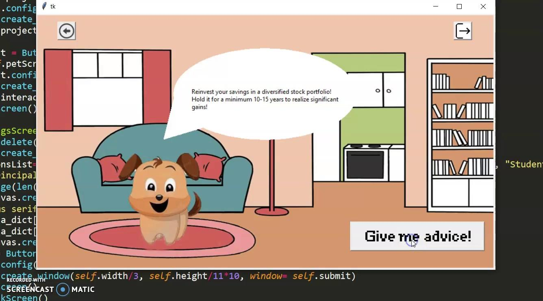
Interaction with Pet
Your pet dog can give you various financial tips. In the final version this would be connected to a news site, so Arbitrage will give you advice depending on current markets.

Slide 10



Reward:
Satisfied and Playful Dog (+5 points):
When you spend within your weekly budget
Affectionate and Loving Dog (+1 point):
When you log in your expenses on that day

Slide 11



Punishment:
Sick Dog:
When you overspend your weekly budget
Crying Dog:
When you forget to log in your expenses for the day

Slide 12
Thank You

